Slide 1
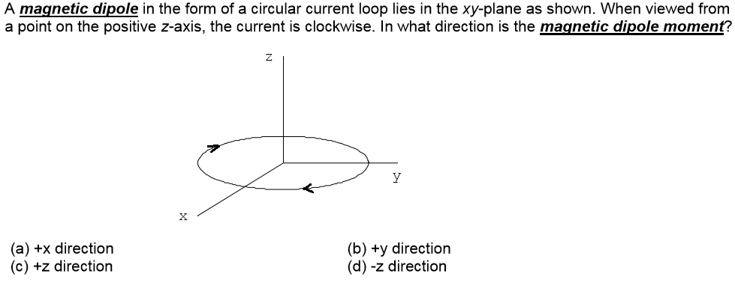
D

Slide 2
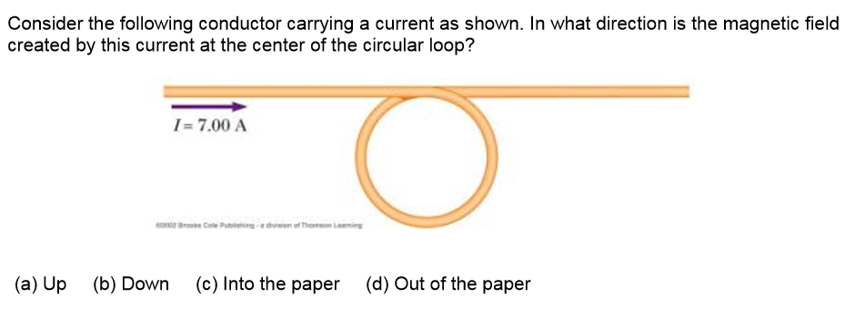
. . . . . . . . .
x x x x x x x x
x
C

Slide 3
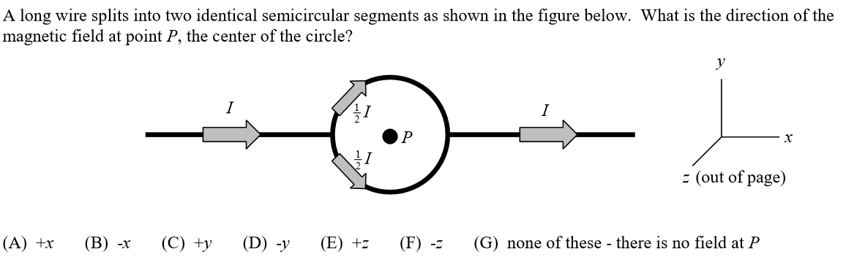
.
x
G

Slide 4
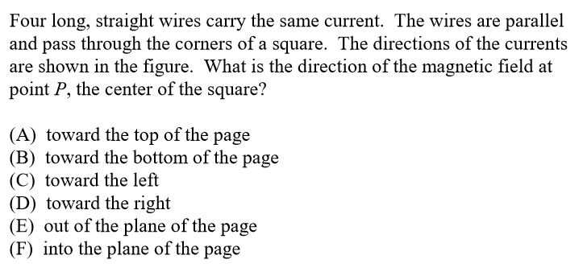
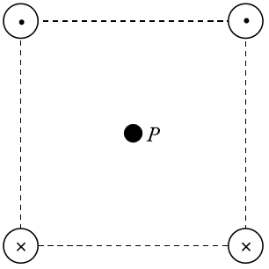
D

Slide 5
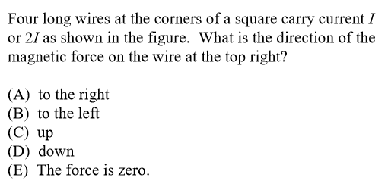
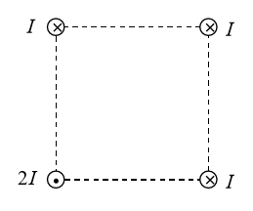
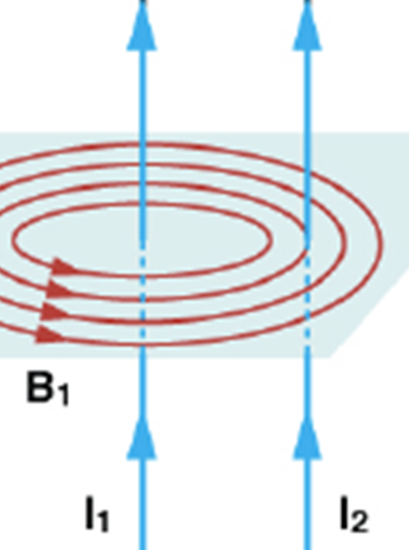
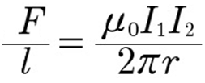
$$\sim \frac{2I}{\sqrt{2}a}=\frac{\sqrt{2}I}{a}$$
$$\sim \frac{I}{a}$$
$$\sim \frac{I}{a}$$
E
Same direction
attractive
opposite direction
repulsive

Slide 6
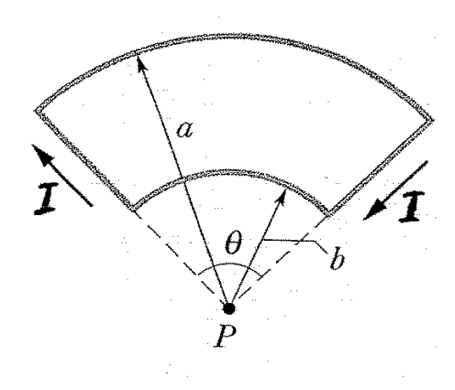

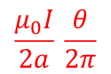
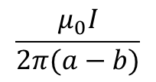
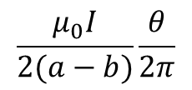
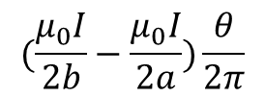
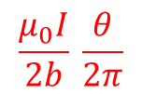
$$\frac{μ_{0}I}{2(a−b)}\frac{θ}{2π}$$
A
X
.
$$(\frac{μ_{0}I}{2b}−\frac{μ_{0}I}{2a})\frac{θ}{2π}$$
B
B
$$\frac{μ_{0}I}{2π(a−b)}$$
0
C
$$\frac{μ_{0}I}{2a} \frac{θ}{2π}$$
X
D
.
0
$$\frac{μ_{0}I}{2b} \frac{θ}{2π}$$

Slide 7
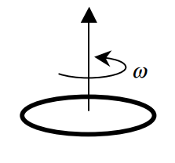

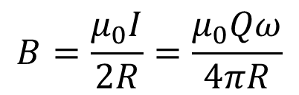
A uniformly charged ring of radius R, charge +Q, and centered at the origin in the xy plane rotates uniformly at an angular velocity ω about its axis. Determine the electric and magnetic fields at the center of the ring.
E = 0
$$B=\frac{μ_{0}I}{2R}=\frac{μ_{0}Qω}{4πR}$$

Slide 8
Two sections of current are not parallel to each other. What is the direction of the magnetic force from I₁ on I₂?
A
F₁₂
What is the direction of the magnetic force from I₂ on I₁?
I₁
I₂
F₂₁
.
B₁
B₂
X
B
A
B
C
D
E
F
.
X
It violates Newton’s 3rd law?

Slide 9
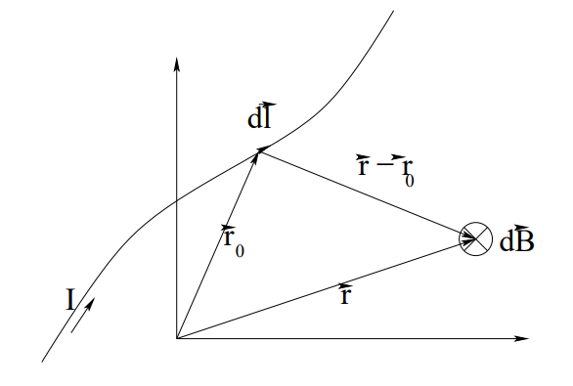
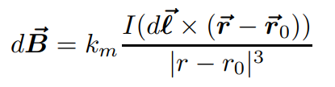


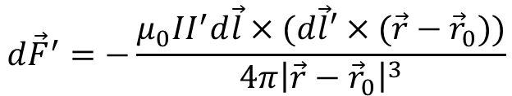
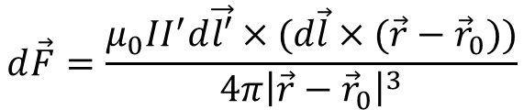
可以不录入超星
The Biot-Savart Law
dl’
I’
$$d\vec{F}=\frac{μ_{0}II^{′}d\vec{l′}×(d\vec{l}×(\vec{r}−{\vec{r}}_{0}))}{4π{\left|\vec{r}−{\vec{r}}_{0}\right|}^{3}}$$
Usually different!
$$d{\vec{F}}^{′}=−\frac{μ_{0}II^{′}d\vec{l}×(d\vec{l}′×(\vec{r}−{\vec{r}}_{0}))}{4π{\left|\vec{r}−{\vec{r}}_{0}\right|}^{3}}$$

